Slide 1
Planning Commission 2024 Comprehensive Plan Update - Briefing
June 16, 2022

Slide 2
Presentation goals
Commissioners receive an overview of state, regional, and local requirements which will inform the Comprehensive Plan update
Commissioners are briefed on key issues and topics which may be important during the update
Answer questions from the Planning Commission
Growth Management Act (GMA)
Puget Sound Regional Council – VISION 2050
Countywide Planning Policies
Comp. Plan
Development Regulations

Slide 3
Comprehensive Plan- background and purpose
Growth Management Act (GMA)
Puget Sound Regional Council – VISION 2050
Countywide Planning Policies
Comp. Plan
Development Regulations

Slide 4
Growth Management Act
Enacted in 1990
Provides a framework for state, regional, county, and local planning coordination.
Requires fast-growing cities and counties to develop a comprehensive plan to manage their growth.
Updated every 10 years – December 2024 deadline
Modeled as a bottoms up planning process
Local decisions
State and regional framework

Slide 5
14 Planning Goals
GMA Goals (RCW 36.70A.020)
Concentrated urban growth Sprawl reduction Regional transportation Affordable housing Economic development | Property Permit processing Natural resource industries Open space and recreation Environmental protection | Early and continuous public participation Public facilities and services Historic preservation Shoreline management
Notes:
Goals implemented through the development of a comprehensive plan and other statutes
Example outside the GMA – local project review act (RCW 36.70B)

Slide 6
Goal implementation
Mandatory Comp Plan Elements for the City Mill Creek (RCW 36.70A.070) | Optional Comp Plan Elements
Land Use Housing Capital Facilities Plan Utilities Transportation | Economic Development Parks and Recreation Conservation Solar Energy Recreation Subarea Plans (neighborhoods, rural villages, urban growth areas, tribal areas, etc.)

Slide 7
Update requirements
Update policies and regulations consistent with:
New or revised regional policies
Case law
Statutory changes
Best Available Science (BAS)
Plan for growth (population and employment) for the next 20 years

Slide 8
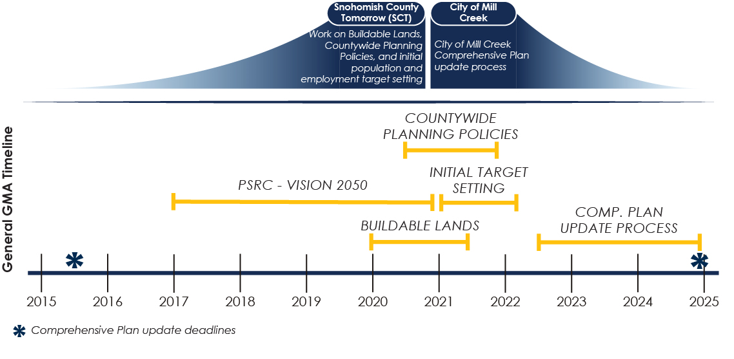
Update timeline

Slide 9
Regional Planning – Puget Sound Regional Council (PSRC)
Growth Management Act (GMA)
Puget Sound Regional Council – VISION 2050
Countywide Planning Policies
Comp. Plan
Development Regulations

Slide 10
PSRC - background
Regional transportation and planning organization- Snohomish, King, Pierce, and Kitsap Counties. Focuses on:
Transportation funding - over $240 million in transportation funding each year.
Regional Transportation Plan. Focuses on improving mobility, transportation choices, freight movement freight.
Economic development strategy. Identifies the leading drivers of the region’s economy and the near term actions that will sustain job growth and global competitiveness.
Planning - Develops policies and about regional growth

Slide 11
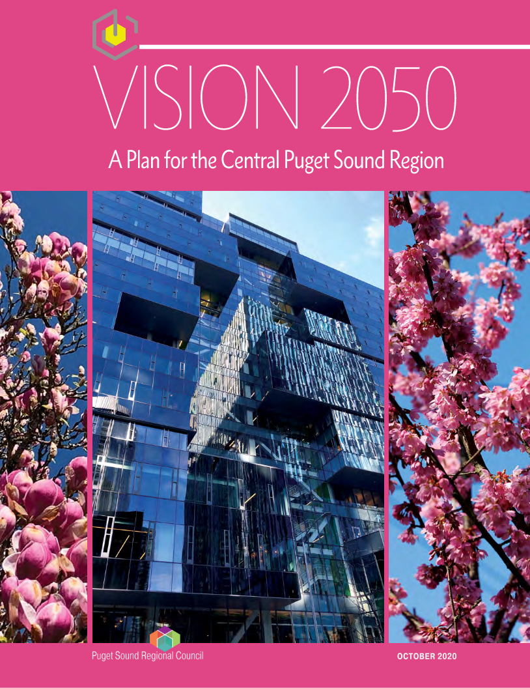
Role in planning
VISION 2050’s multicounty planning policies and regional growth strategy guide how the four-county region grows.
Multicounty planning policies and regional growth strategy implemented through Countywide Planning Policies, comprehensive plans, and development regulations.

Slide 12
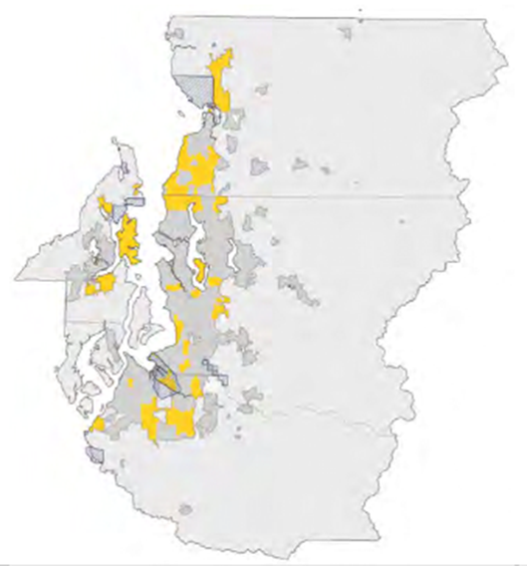
VISION 2050
Focused on growth which will occur in the four county region by 2050:
1.6 million people
1.2 million jobs
New and revised policies – focus areas in Vision include new and revised policies concerning:
Climate change
Equity
Displacement
Housing
Vision 2050 implemented through Countywide Planning Policies
Including policies and growth planning

Slide 13
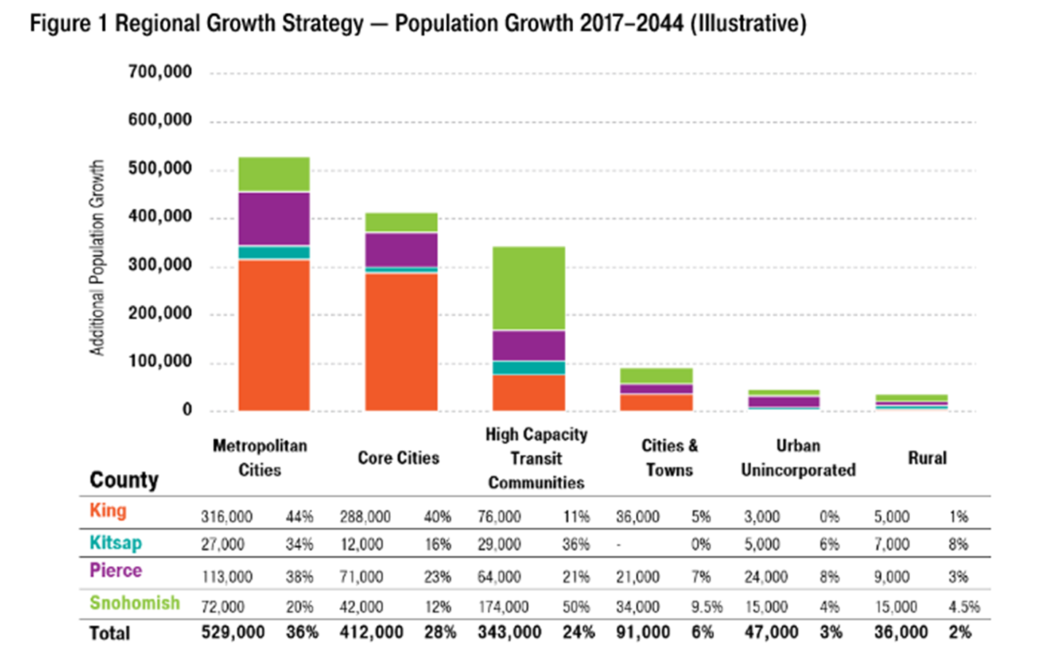
How population is allocated through Vision
Source: PSRC Vision 2050
Notes:
Allocations growth by Regional Geographies
Growth focused in our most urban areas
Mill Creek is within the High Capacity Transit Community RG.
High Capacity Transit Communities (34 total, 274 square miles): Arlington, Bothell Municipal Urban Growth Area (MUGA), Edmonds, Edmonds MUGA, Everett MUGA, Larch Way Overlap, Lynnwood MUGA, Marysville, Mercer Island, Mill Creek, Mill Creek MUGA, Mountlake Terrace, Mukilteo, Mukilteo MUGA,

Slide 14
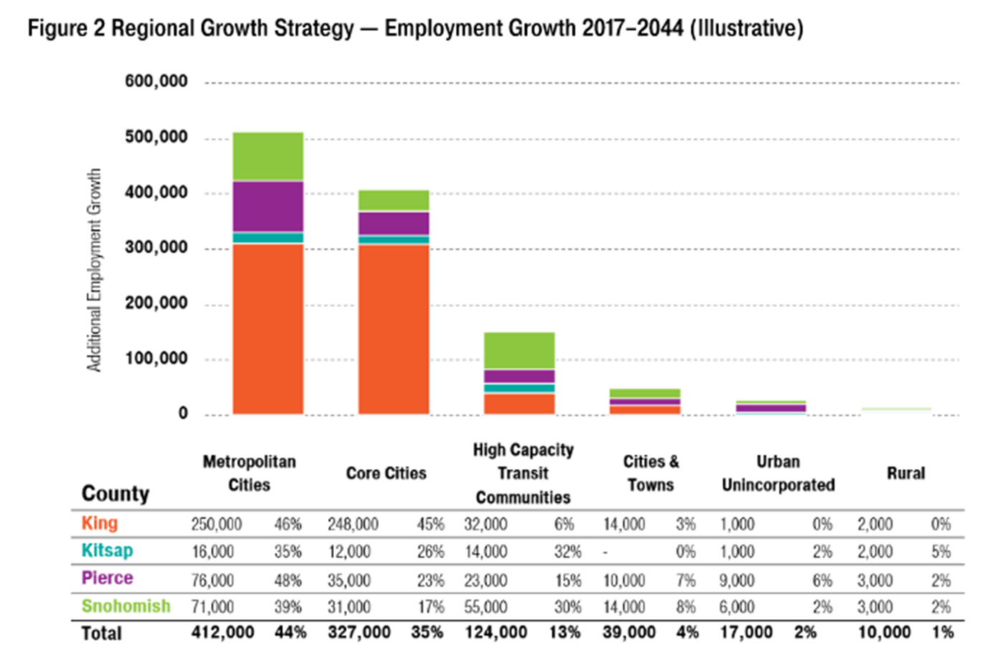
How employment is allocated through Vision
Source: PSRC Vision 2050

Slide 15
Countywide Planning Policies
Growth Management Act (GMA)
Puget Sound Regional Council – VISION 2050
Countywide Planning Policies
Comp. Plan
Development Regulations

Slide 16
2024 Comprehensive Plan Update - Briefing
Countywide Planning Policies
Ensures coordinated growth between a county and the cities within the county. Covers issues such as transportation, capital facility planning, housing, and growth.
Growth Management Act outlines a… "countywide planning policy is a written policy statement or statements used solely for establishing a countywide framework from which county and city comprehensive plans are developed and adopted… This framework shall ensure that city and county comprehensive plans are consistent”.
CPPs are required to be consistent with:
GMA requirements for Countywide Planning Policies in RCW 36.70A.210
Multi-County Planning Policies (MPPs) contained in VISION 2050

Slide 17
Mill Creek 2024-2044 Comprehensive Plan update
Growth Management Act (GMA)
Puget Sound Regional Council – VISION 2050
Countywide Planning Policies
Comp. Plan
Development Regulations

Slide 18
Update timeline

Slide 19
General Overview
Requirement to meet GMA and PSRC requirements
GMA requirements met by updating the comprehensive plan (including growth targets) and implementing development regulations consistent with:
State law changes and case law
Best Available Science for critical areas
PSRC consistency met by updating policies and growth targets consistent with VISION 2050.
Countywide Planning Policies implement VISION 2050
Not required to create new or amended policies for every CPP/MPP
PSRC certifies update once adopted
Update should involve strong community engagement

Slide 20
2024 Comprehensive Plan Update - Briefing
Key issues – GMA
Funding for update provided – 125K
Critical areas update complete – early action
New state laws to implement
HB 1220 substantially amends housing-related provisions of the Growth Management Act (GMA)
HB 1717 adds new requirements regarding tribal participation in planning efforts with local and regional jurisdictions
Several other smaller bills
Notes:
Go over funding allocation
Discuss laws that did not pass

Slide 21
Key issues – PSRC
New and revised policies in VISION 2050 and Countywide Planning Policies. Important topics include:
Equity
Climate change
Displacement/Housing
Growth Targets (population and employment)
Targets adopted in Countywide Planning Policies (CPPs) must be one of the alternatives studied
If the assigned target in the CPPs is not ultimately adopted then city will have to:
Reconcile targets within the CPPs
Ensure target adopted are consistent with VISION 2050

Slide 22
Growth Targets
New and revised policies in VISION 2050 and Countywide Planning Policies. Important topics include:
Equity
Climate change
Displacement/Housing
Growth Targets (population and employment)
Targets adopted in Countywide Planning Policies (CPPs) must be one of the alternatives studied
If the assigned target in the CPPs is not ultimately adopted then city will have to:
Reconcile targets within the CPPs
Ensure target adopted are consistent with VISION 2050

Slide 23
2044 Initial population target
Initial population target – Mill Creek vs. County total
 | 2019 | 2044 | Difference | % of county total
City of Mill Creek | 20,926 | 24,813 | 3,887 | 1.3%
County Total | 827,957 | 1,136,309 | 308,352 | 100%
Buildable Lands Report found that Mill Creek currently has about 1,520 in population capacity
Approximately 2,367 in additional capacity needed for 2044 target
NOTE: Future annexations will not count towards this total

Slide 24
2044 Initial employment target
Initial employment target – Mill Creek vs. County total
 | 2019 | 2044 | Difference | % of county total
City of Mill Creek | 6,787 | 7,523 | 736 | .4%
County Total | 827,957 | 1,136,309 | 308,352 | 100%
Buildable Lands Report found that Mill Creek currently has about 858 in employment capacity
New capacity may not be necessary but could be included

Slide 25
Accommodating growth
Options could include:
Consideration of Mill Creek subarea plan
Zoning changes in other areas of the City
Important to note that beyond growth targets there is the requirement to meet GMA Housing Element requirements

Slide 26
Project next steps
Develop project schedule and engagement strategy
Develop work program
Work with the Planning Commission and Council to define and refine the scope of work for the project

Slide 27
Questions?

